Slide 1


Consciousness
[Instructor Name]
[Class and Section Number]
Notes:
This module can be covered in a single class period.

Slide 2
Overview
Conscious Experiences
Consciousness & Visual Perception
Consciousness & Memory
Consciousness & Body Awareness
Consciousness & Decision Making
Understanding Consciousness
Notes:
The purpose of this slide is to provide an overview of the material that will be covered during the lecture.
Technical Note: These slides may contain simple click animation so that you can focus students’ attention on a particular question, a selection of text, or an image and not have them be distracted by reading ahead. You can either preview the sequence of animation by going through the slides in slideshow view, visiting the animations tab, or reviewing the slide notes. In the notes you will see a cue - (Click) – that corresponds to each animation.
You will also find hyperlinks to outside videos at various places in the slides. These hyperlinks are embedded in text and indicated by color and in the notes section.

Slide 3
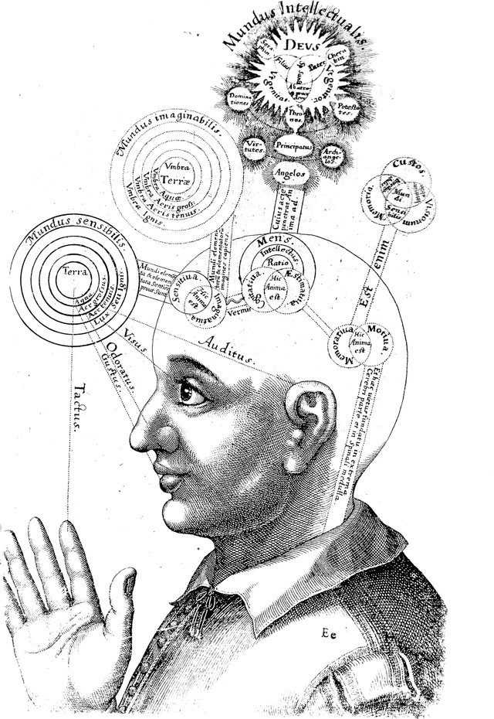
What is Consciousness?
Notes:
This slide begins a discussion regarding the students’ definition of consciousness. Pictured is a representation of consciousness drawn in the 17th century.
Discussion question: What do you think consciousness is?
Instructor’s note: Put up their answers on a slide or on the board. This will allow students to experience the complexity of defining a term (i.e., consciousness) that students frequently use within their daily vocabulary, but rarely explore. You will likely obtain a variety of answers from students, many of which center around the key role of awareness. Once this is completed, you should read aloud the quote by Hippocrates on the next slide.

Slide 4
What is Consciousness?
“Men ought to know that from the brain, and from the brain only, arise our pleasures, joys, laughter and jests, as well as our sorrows, pains, griefs and tears. Through it, in particular, we think, see, hear, and distinguish the ugly from the beautiful, the bad from the good, the pleasant from the unpleasant…”
-Hippocrates
Notes:
This slide continues that discussion initiated in slide 3.
Instructor’s note: Read this quote aloud.
Discussion question: What do you believe Hippocrates meant by this?
Explanation: Hippocrates’s emphasis of the role of the brain in conscious experience is a fitting introduction to the lecture given the Noba module they have just read describes consciousness as it relates to neuronal activity and brain areas.
Discussion question: Describe John Serle’s definition of consciousness: that it “consists of inner, qualitative, subjective states and feelings or awareness”. Ask students if they would add anything to this definition.

Slide 5

Conscious Experiences
Notes:
This slide introduces the idiosyncratic and personal nature of consciousness and explains the specific conscious experience/awareness that will be discussed in this lecture.
Discussion question: How does this picture relate to consciousness?
Answers will vary.
Explanation: The picture of the Seattle skyline seen through a glasses lens is intended to allude to the unique and direct knowledge that only the individual can know about him or herself. Contemplate the unique experience of being you at this moment! You, and only you, have direct knowledge of your own conscious experiences. At the same time, you cannot know consciousness from anyone else’s inside view.
Discussion question: How can we begin to understand this fantastic ability to have private, conscious experiences?
Explanation: In a sense, everything you know is from your own vantage point, with your own consciousness at the center. Yet the scientific study of consciousness confronts the challenge of producing general understanding that goes beyond what can be known from one individual’s perspective.
To delve into this topic, some terminology must first be considered. The term consciousness can denote the ability of a person to generate a series of conscious experiences one after another. Here we include experiences of feeling and understanding sensory input, of a temporal sequence of autobiographical events, of imagination, of emotions and moods, of ideas, of memories—the whole range of mental contents open to an individual.
Consciousness can also refer to the state of an individual, as in a sharp or dull state of consciousness, a drug-induced state such as euphoria, or a diminished state due to drowsiness, sleep, neurological abnormality, or coma. In this chapter, we focus not on states of consciousness or on self-consciousness, but rather on the process that unfolds in the course of a conscious experience—a moment of awareness—the essential ingredient of consciousness.

Slide 6

Conscious Experiences
Notes:
This slide explores the inherent difficulty of making inferences regarding the consciousness of others. The picture is intended to humorously allude to the way in which we are sometimes able to correctly infer details about another individual’s consciousness, and other times we are completely incorrect. Just as the psychic may have been accurate in certain predictions, he or she likely did not see the pending eviction coming (indicated by the graffiti on the window, which reads “Bet you coulda predicted that”).
Discussion question: Have you ever experienced the sense of knowing exactly what a friend is thinking? What do you think causes that to happen?
Explanation: Various signs can guide our inferences about consciousness in others. We can try to infer what’s going on in someone else’s mind by relying on the assumption that they feel what we imagine we would feel in the same situation. We might account for someone’s actions or emotional expressions through our knowledge of that individual and our careful observations of their behavior. In this way, we often display substantial insight into what they are thinking. Other times we are completely wrong.
By measuring brain activity using various neuroscientific technologies, we can acquire additional information useful for deciphering another person’s state of mind. In special circumstances such inferences can be highly accurate, but limitations on mind reading remain, highlighting the difficulty of understanding exactly how conscious experiences arise.
Attempts to understand consciousness have been pervasive throughout human history, mostly dominated by philosophical analyses focused on the first-person perspective. Now we have a wider set of approaches that includes philosophy, psychology, neuroscience, cognitive science, and contemplative science.
The challenge for this combination of approaches is to give a comprehensive explanation of consciousness. That explanation would include describing the benefits of consciousness, particularly for behavioral capabilities that conscious experiences allow, that trump automatic behaviors. Subjective experiences also need to be described in a way that logically shows how they result from precursor events in the human brain. Moreover, a full account would describe how consciousness depends on biological, environmental, social, cultural, and developmental factors.

Slide 7
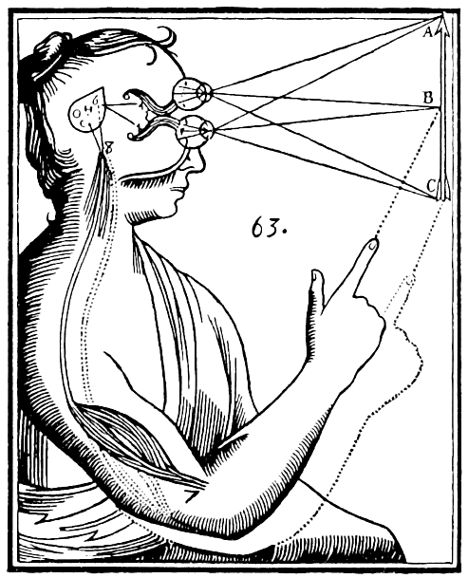
Conscious Experiences
Notes:
This slide introduces two theories related to the interaction between conscious thoughts and the physical world: Dualism (pictured) and Reductionism.
Lecture Info: At the outset, a central question is how to conceive of consciousness relative to other things we know. Objects in our environment have a physical basis and are understood to be composed of constituents, such that they can be broken down into molecules, elements, atoms, particles, and so on. Yet we can also understand things relationally and conceptually. Sometimes a phenomenon can best be conceived as a process rather than a physical entity (e.g., digestion is a process whereby food is broken down).
Discussion question: With this in mind, what do you think the relationship is between our conscious thoughts and the physical universe, and in particular, our brains?
Possible answers: Students may share that we use sensory input in the brain to construct conscious thoughts. The physical world gives us logical parameters in order to construct a consciousness. Also, we make conscious decisions about how we behave in the physical world.
Explanation: Rene Decartes’s position, dualism, was that mental and physical are, in essence, different substances. This view can be contrasted with reductionist views that mental phenomena can be explained via descriptions of physical phenomena. Although the dualism/reductionism debate continues, there are many ways in which the mind can be shown to depend on the brain.
A prominent orientation to the scientific study of consciousness is to seek understanding of these dependencies—to see how much light they can shed on consciousness. Significant advances in our knowledge about consciousness have thus been gained, as seen in the following examples.

Slide 8
Overview
Conscious Experiences
Consciousness & Visual Perception
Consciousness & Memory
Consciousness & Body Awareness
Consciousness & Decision Making
Understanding Consciousness
Notes:
The purpose of this slide is to provide an overview of the material that will be covered during the lecture.

Slide 9

Consciousness & Visual Perception
Motion-Induced Blindness
Notes:
The purpose of this slide is to introduce the concept of motion-induced blindness.
Lecture Info: Suppose you meet your friend at a crowded train station. You may notice a subtle smile on her face. At that moment you are probably unaware of many other things happening within your view. What makes you aware of some things but not others? You probably have your own intuitions about this, but experiments have proven wrong many common intuitions about what generates visual awareness.
For instance, you may think that if you attentively look at a bright spot, you must be aware of it. Not so. In a phenomenon known as motion-induced blindness, bright discs completely vanish from your awareness in full attention.
Demonstration: Motion-Induced Blindness
Go to http://www.michaelbach.de/ot/mot-mib/index.html
Ask students to fixate on the center at the flashing green light and then ask them what happens.
The students may report that after a little while, the yellow dots disappear either all at the same time, in pairs, or individually. Then, they randomly reappear again.
In reality, the yellow dots are there the entire time! When we fixate on something, objects on the periphery start to disappear. When we blink or even shift our gaze slightly, the same objects will reappear.
Discussion questions: Ask your students what they think would happen if the background was a different color? What if the dots were smaller or the speed of the rotating pattern was faster? How about slower? Michael Bach’s website gives you the option to test out all of these scenarios with your students.
You may also think that if you deeply analyze an image, decoding its meaning and making a decision about it, you must be aware of the image. Not necessarily. When a number is briefly flashed and rapidly replaced by a random pattern, you may have no awareness of it, despite the fact that your brain allows you to determine that the number is greater than 5 and then prepares your right hand for a key press if that is what you were instructed to do (Dehaene et al., 1998).
Thus, neither the brightness of an image, paying full attention to it, nor deeply analyzing it guarantees that you will be aware of it.

Slide 10
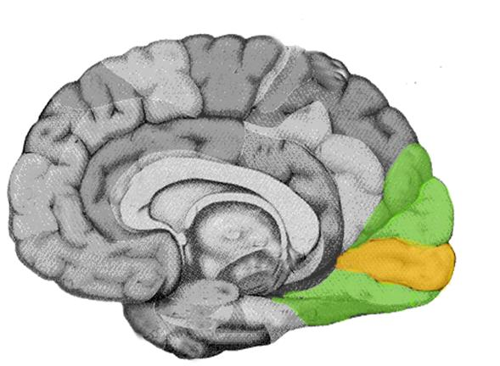
Consciousness & Visual Perception
Cortical Blindness
Blindsight
Notes:
This slide introduces two key concepts: Cortical Blindness and Blindsight.
Discussion question: What do you think the crucial ingredient is of visual awareness?
Explanation: A contemporary answer is that our awareness of a visual feature depends on a certain type of reciprocal exchange of information across multiple brain areas, particularly in the cerebral cortex. As an illustration, directly activating your visual motion area (known as V5) with an externally applied magnetic field (transcranial magnetic stimulation) will make you see moving dots. This is not surprising. What is surprising is that activating your visual motion area alone does not let you see motion. You will not see moving dots if the feedback signal from V5 to the primary visual cortex is disrupted by a further transcranial magnetic stimulation pulse (Pascual-Leone & Walsh, 2001). The reverberating reciprocal exchange of information between higher-level visual areas and primary visual cortex appears to be essential for generating visual awareness.
Pictured is an image of the brain with the visual cortex highlighted.
This idea can also explain why people with certain types of brain damage lack visual awareness. Consider a patient with brain damage limited to primary visual cortex who claims not to see anything — a problem termed cortical blindness. Other areas of visual cortex may still receive visual input through projections from brain structures such as the thalamus and superior colliculus, and these networks may mediate some preserved visual abilities that take place without awareness. For example, a patient with cortical blindness might detect moving stimuli via V5 activation but still have no conscious experiences of the stimuli, because the reverberating reciprocal exchange of information cannot take place between V5 and the damaged primary visual cortex. The preserved ability to detect motion might be evident only when a guess is required (“guess whether something moved to the left or right”)—otherwise the answer would be “I didn’t see anything.” This phenomenon of blindsight refers to blindness due to a neurological cause that preserves abilities to analyze and respond to visual stimuli that are not consciously experienced (Lamme, 2001).
Discussion: Share with students the following scenario/question: Imagine you are a doctor testing a patient who received a blow to the head while playing football and now has some brain damage. You have run some tests and at this point you have discovered that the patient is blind. As a final test, you present a red plate to the patient and ask a very simple question: “Do you see the red plate in front of you?” The patient replies that he does not. This makes sense because you know that the patient is blind. But you try something a little different. You ask the patient if they can point in the direction of the red plate; is the plate to their right or left? Do you think the patient guesses correctly or not? In fact, the patient is able to point in the right direction even though they have just told you that they can’t see the red plate (which they really can’t).
Video: Consider showing this 8-minute video (or parts of it) of a man with blindsight.

Slide 11
Consciousness & Visual Perception
Global Neuronal Workspace Theory – Awareness requires the sharing of information among prefrontal, inferior parietal, and occipital regions of the cerebral cortex
Information Integration Theory – The level of awareness depends entirely on the complexity of the structure of shared information
Notes:
This slide introduces two theories of the way in which structures of the brain interact to produce awareness: Global Neuronal Workspace Theory and Information Integration Theory.
(Click) Global Neuronal Workspace Theory
Lecture Info: If exchanges of information across brain areas are crucial for generating visual awareness, neural synchronization must play an important role because it promotes neural communication. The Global Neuronal Workspace Theory of Consciousness (Dehaene & Changeux, 2011) postulates that sharing of information among prefrontal, inferior parietal, and occipital regions of the cerebral cortex is especially important for generating awareness.
(Click) Information integration Theory
A related view, the Information Integration Theory of Consciousness, is that shared information itself constitutes consciousness (Tononi, 2004). An organism would have minimal consciousness if the structure of shared information is simple, whereas it would have rich conscious experiences if the structure of shared information is complex.
Further explanation: Roughly speaking, complexity is defined as the number of intricately interrelated informational units or ideas generated by a web of local and global sharing of information. The degree of consciousness in an organism (or a machine) would be high if numerous and diversely interrelated ideas arise, low if only a few ideas arise or if there are numerous ideas but they are random and unassociated. Computational analyses provide additional perspectives on such proposals. In particular, if every neuron is connected to every other neuron, all neurons would tend to activate together, generating few distinctive ideas. With a very low level of neuronal connectivity at the other extreme, all neurons would tend to activate independently, generating numerous but unassociated ideas.
To promote a rich level of consciousness, then, a suitable mixture of short-, medium-, and long-range neural connections would be needed. The human cerebral cortex may indeed have such an optimum structure of neural connectivity. Given how consciousness is conceptualized in this theory as graded rather than all-or-none, a quantitative approach (e.g., Casali et al., 2013; Monti et al., 2013) could conceivably be used to estimate the level of consciousness in nonhuman species and artificial beings.

Slide 12
Overview
Conscious Experiences
Consciousness & Visual Perception
Consciousness & Memory
Consciousness & Body Awareness
Consciousness & Decision Making
Understanding Consciousness
Notes:
The purpose of this slide is to provide an overview of the material that will be covered during the lecture.

Slide 13
Consciousness and Memory
Perceptual Priming – Fluency of processing produced by prior experience, even when experience is not remembered
Notes:
This slide discusses phenomena related to memory.
Instructor’s note: Here you will introduce the concept of perceptual priming. Notice that the picture is of the same smiling female portrayed in slide 9. The intention here is to reference the perceptual priming experiments described below, in which an individual is better able to recognize a word or face that they have previously experienced. It should be made clear to the students that, while they likely remember this picture, this previous exposure does not need to be something that they can remember to have a priming effect.
Lecture Info: The pinnacle of conscious human memory function is known as episodic recollection because it allows one to re-experience the past, to virtually relive an earlier event. People who suffer from amnesia due to neurological damage to certain critical brain areas have poor memory for events and facts. Their memory deficit disrupts the type of memory termed declarative memory and makes it difficult to consciously remember. However, amnesic insults typically spare a set of memory functions that do not involve conscious remembering. These other types of memory, which include various habits, motor skills, cognitive skills, and procedures, can be demonstrated when an individual executes various actions as a function of prior learning, but in these cases a conscious experience of remembering is not necessarily included.
Research on amnesia has thus supported the proposal that conscious remembering requires a specific set of brain operations that depend on networks of neurons in the cerebral cortex. Some of the other types of memory involve only subcortical brain regions, but there are also notable exceptions. In particular, perceptual priming is a type of memory that does not entail the conscious experience of remembering and that is typically preserved in amnesia. Perceptual priming is thought to reflect a fluency of processing produced by a prior experience, even when the individual cannot remember that prior experience. For example, a word or face might be perceived more efficiently if it had been viewed minutes earlier than if it hadn’t. Whereas a person with amnesia can demonstrate this item-specific fluency due to changes in corresponding cortical areas, they nevertheless would be impaired if asked to recognize the words or faces they previously experienced. A reasonable conclusion on the basis of this evidence is that remembering an episode is a conscious experience not merely due to the involvement of one portion of the cerebral cortex, but rather due to the specific configuration of cortical activity involved in the sharing or integration of information.

Slide 14
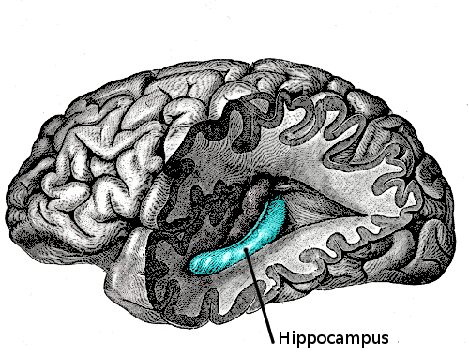
Consciousness & Memory
Hippocampus Cerebral Cortex
Notes:
This slide discusses the interplay between areas of the brain necessary to achieve conscious recollection.
Lecture Info: Further neuroscientific studies of memory retrieval have shed additional light on the necessary steps for conscious recollection. For example, storing memories for the events we experience each day appears to depend on connections among multiple cortical regions as well as on a brain structure known as the hippocampus. Memory storage becomes more secure due to interactions between the hippocampus and cerebral cortex that can transpire over extended time periods following the initial registration of information. Conscious retrieval thus depends on the activity of elaborate sets of networks in the cortex. Memory retrieval that does not include conscious recollection depends either on restricted portions of the cortex or on brain regions separate from the cortex.
The ways in which memory expressions that include the awareness of remembering differ from those that do not thus highlight the special nature of conscious memory experiences (Paller, Voss, & Westerberg, 2009; Voss, Lucas, & Paller, 2012). Indeed, memory storage in the brain can be very complex for many different types of memory, but there are specific physiological prerequisites for the type of memory that coincides with conscious recollection.

Slide 15
Overview
Conscious Experiences
Consciousness & Visual Perception
Consciousness & Memory
Consciousness & Body Awareness
Consciousness & Decision Making
Understanding Consciousness
Notes:
The purpose of this slide is to provide an overview of the material that will be covered during the lecture.

Slide 16
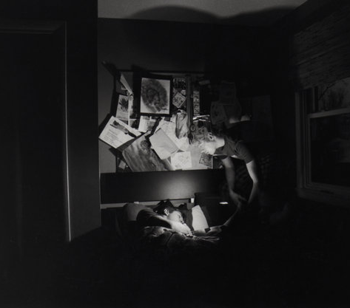
Consciousness & Body Awareness
Coincident Sensations
Presence
Social Neuroscience
Notes:
This slide begins a discussion regarding the way in which consciousness can influence body sensations. This includes the introduction of coincident sensations, presence, and the Social Neuroscience Theory of Consciousness. Pictured is a portrayal of an out-of-body experience, discussed further below.
Demonstration: Ask students to rub their left arm wit their right hand. Do you feel the rubbing sensation only in your arm or also in your hand? What kind of information can you collect about yourself and your body through this sensation?
(Click) Coincident Sensations
Explanation: The brain can generate body awareness by registering coincident sensations. For example, when you rub your arm, you see your hand rubbing your arm and simultaneously feel the rubbing sensation in both your hand and your arm. This simultaneity tells you that it is your hand and your arm. Infants use the same type of coincident sensations to initially develop the self/nonself distinction that is fundamental to our construal of the world.
Video: The fact that your brain constructs body awareness in this way can be experienced via the rubber-hand illusion shown in this video (also linked to “Coincident Sensations” in the slide): https://www.youtube.com/watch?v=Qsmkgi7FgEo. If you see a rubber hand being rubbed and simultaneously feel the corresponding rubbing sensation on your own body out of view, you will momentarily feel a bizarre sensation—that the rubber hand is your own.
The construction of our body awareness appears to be mediated by specific brain mechanisms involving a region of the cortex known as the temporoparietal junction. Damage to this brain region can generate distorted body awareness, such as feeling a substantially elongated torso.
(Click) Presence
Video: Altered neural activity in this region through artificial stimulation can also produce an out-of-body experience as shown in this video (also linked to “Presence” in the slide): https://www.youtube.com/watch?v=4PQAc_Z2OfQ, in which you feel like your body is in another location and you have a novel perspective on your body and the world, such as from the ceiling of the room.
Remarkably, comparable brain mechanisms may also generate the normal awareness of the sense of self and the sensation of being inside a body. In the context of virtual reality this sensation is known as presence (the compelling experience of actually being there). Our normal localization of the self may be equally artificial, in that it is not a given aspect of life but is constructed through a special brain mechanism.
(Click) Social Neuroscience
A Social Neuroscience Theory of Consciousness (Graziano & Kastner, 2011) ascribes an important role to our ability to localize our own sense of self. The main premise of the theory is that you fare better in a social environment to the extent that you can predict what people are going to do. So, the human brain has developed mechanisms to construct models of other people’s attention and intention, and to localize those models in the corresponding people’s heads to keep track of them. The proposal is that the same brain mechanism was adapted to construct a model of one’s own attention and intention, which is then localized in one’s own head and perceived as consciousness. If so, then the primary function of consciousness is to allow us to predict our own behavior. Research is needed to test the major predictions of this new theory, such as whether changes in consciousness (e.g., due to normal fluctuations, psychiatric disease, brain damage) are closely associated with changes in the brain mechanisms that allow us to model other people’s attention and intention.

Slide 17
Overview
Conscious Experiences
Consciousness & Visual Perception
Consciousness & Memory
Consciousness & Body Awareness
Consciousness & Decision Making
Understanding Consciousness
Notes:
The purpose of this slide is to provide an overview of the material that will be covered during the lecture.

Slide 18

Consciousness & Decision Making
Volition →
Consciousness
Gut Decision →
Unconscious
Notes:
This slide describes the role of volition within the context of our subjective feelings of consciousness, and introduces the dichotomy of conscious volition and unconscious gut decision.
Lecture Info: Choosing among multiple possible actions, the sense of volition, is closely associated with our subjective feeling of consciousness. When we make a lot of decisions, we may feel especially conscious and then feel exhausted, as if our mental energy has been drained. We make decisions in two distinct ways. Sometimes we carefully analyze and weigh different factors to reach a decision, taking full advantage of the brain’s conscious mode of information processing. Other times we make a gut decision, trusting the unconscious mode of information processing (although it still depends on the brain). The unconscious mode is adept at simultaneously considering numerous factors in parallel, which can yield an overall impression of the sum total of evidence. In this case, we have no awareness of the individual considerations. In the conscious mode, in contrast, we can carefully scrutinize each factor—although the act of focusing on a specific factor can interfere with weighing in other factors.
Discussion question: Based on this information, when might it be best to make gut decisions? What about carefully considered, conscious decisions?
Explanation: One might try to optimize decision making by taking into account these two strategies. A careful conscious decision should be effective when there are only a few known factors to consider. A gut decision should be effective when a large number of factors should be considered simultaneously. Gut decisions can indeed be accurate on occasion (e.g., guessing which of many teams will win a close competition), but only if you are well versed in the relevant domain (Dane, Rockmann, & Pratt, 2012).
As we learn from our experiences, some of this gradual knowledge accrual is unconscious; we don’t know we have it and we can use it without knowing it. On the other hand, consciously acquired information can be uniquely beneficial by allowing additional stages of control (de Lange, van Gaal, Lamme, & Dehaene, 2011). It is often helpful to control which new knowledge we acquire and which stored information we retrieve in accordance with our conscious goals and beliefs.
Whether you choose to trust your gut or to carefully analyze the relevant factors, you feel that you freely reach your own decision.
Discussion question: Do you think this feeling of free choice is real?
Explanation: Contemporary experimental techniques fall short of answering this existential question. However, it is likely that at least the sense of immediacy of our decisions is an illusion.

Slide 19

Consciousness & Decision Making
Do you turn left or right?
Notes:
This slide furthers the discussion regarding the presence (or lack) of free will within our decision making.
Lecture Info: In one experiment, people were asked to freely consider whether to press the right button or the left button, and to press it when they made the decision (Soon, Brass, Heinze, & Haynes, 2008). Although they indicated that they made the decision immediately before pressing the button, their brain activity, measured using functional magnetic resonance imaging (fMRI), predicted their decision as much as 10 seconds before they said they freely made the decision. In the same way, each conscious experience is likely preceded by precursor brain events that on their own do not entail consciousness but that culminate in a conscious experience.
In many situations, people generate a reason for an action that has nothing to do with the actual basis of the decision to act in a particular way. We all have a propensity to retrospectively produce a reasonable explanation for our behavior, yet our behavior is often the result of unconscious mental processing, not conscious volition.
Discussion question: Why do you think we feel that each of our actions is immediately preceded by our own decision to act?
Explanation: This illusion may help us distinguish our own actions from those of other agents. For example, while walking hand-in-hand with a friend, if you felt you made a decision to turn left immediately before you both turned left, then you know that you initiated the turn; otherwise, you would know that your friend did.
Even if some aspects of the decision-making process are illusory, to what extent are our decisions determined by prior conditions? It certainly seems that we can have full control of some decisions, such as when we create a conscious intention that leads to a specific action: You can decide to go left or go right. To evaluate such impressions, further research must develop a better understanding of the neurocognitive basis of volition, which is a tricky undertaking, given that decisions are conceivably influenced by unconscious processing, neural noise, and the unpredictability of a vast interactive network of neurons in the brain.
Yet belief in free choice has been shown to promote moral behavior, and it is the basis of human notions of justice. The sense of free choice may be a beneficial trait that became prevalent because it helped us flourish as social beings.

Slide 20
Overview
Conscious Experiences
Consciousness & Visual Perception
Consciousness & Memory
Consciousness & Body Awareness
Consciousness & Decision Making
Understanding Consciousness
Notes:
The purpose of this slide is to provide an overview of the material that will be covered during the lecture.

Slide 21
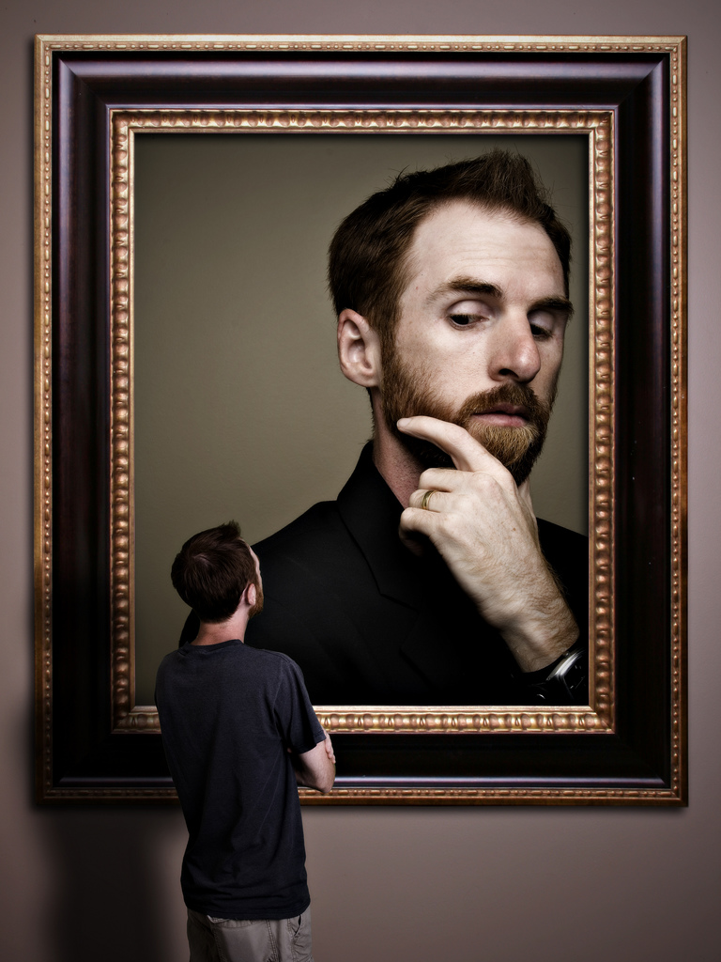
Understanding Consciousness
Third-person Perspective
Future Questions
Notes:
This slide concludes the lecture, introducing third-person perspective (contrasting first-person perspective discussed previously) and introducing several future questions that reflect current directions in consciousness research.
Lecture Info: Our human consciousness unavoidably colors all of our observations and our attempts to gain understanding. Nonetheless, scientific inquiries have provided useful perspectives on consciousness. The advances described previously should engender optimism about the various research strategies applied to date and about the prospects for further insight into consciousness in the future.
Because conscious experiences are inherently private, they have sometimes been taken to be outside the realm of scientific inquiry. This view idealizes science as an endeavor involving only observations that can be verified by multiple observers, relying entirely on the third-person perspective, or the view from nowhere (from no particular perspective). Yet conducting science is a human activity that depends, like other human activities, on individuals and their subjective experiences (first-person). A rational scientific account of the world cannot avoid the fact that people have subjective experiences. Subjectivity thus has a place in science. Conscious experiences can be subjected to systematic analysis and empirical tests to yield progressive understanding.
Discussion questions: Many further questions remain to be addressed by scientists of the future:
Is the first-person perspective of a conscious experience basically the same for all human beings, or do individuals differ fundamentally in their introspective experiences and capabilities?
Should psychological science focus only on ordinary experiences of consciousness, or are extraordinary experiences also relevant?
Can training in introspection lead to a specific sort of expertise with respect to conscious experience? An individual with training, such as through extensive meditation practice, might be able to describe their experiences in a more precise manner, which could then support improved characterizations of consciousness. Such a person might be able to understand subtleties of experience that other individuals fail to notice, and thereby move our understanding of consciousness significantly forward. These and other possibilities await future scientific inquiries into consciousness.
Activity: Consider incorporating the “What Do You Know about Sleep?” activity at the end of your class session. It requires 10-15 minutes and the true/false quiz found in the IM > Consciousness > Module 1: Consciousness > Activities and Demonstrations. Look there for in-depth instructions as well.

Slide 22
Photo Attribution
Slide 16 | Photo Credit: Boo756 http://fav.me/d2o1vi6 http://creativecommons.org/licenses/by-nc-nd/3.0/
Slide 18 | Photo Credit: Dano https://www.flickr.com/photos/36101697408@N01/241256203/ https://creativecommons.org/licenses/by/2.0/
Slide 21 | Photo Credit: Stephen Poff https://www.flickr.com/photos/63824260@N00/2849400717/ https://creativecommons.org/licenses/by-nc-nd/2.0/
Slide 19 | Photo Credit: Éole https://www.flickr.com/photos/73491156@N00/5056183269/ https://creativecommons.org/licenses/by-nc-sa/2.0/
Slide 1 | Photo Credit: Mike Willis http://www.flickr.com/photos/67248612@N00/4478297212 https://creativecommons.org/licenses/by-nd/2.0/
Slide 3 | Photo Credit: Robert Fludd http://commons.wikimedia.org/wiki/File:RobertFuddBewusstsein17Jh.png http://en.wikipedia.org/wiki/public_domain
Slide 5 | Photo Credit: Hackfish http://commons.wikimedia.org/wiki/File:Refraction_through_glasses_090306.jpg http://creativecommons.org/licenses/by-sa/2.5/deed.en
Slide 6 | Photo Credit: Kevin Jarrett http://www.flickr.com/photos/kjarrett/4103092955/in/photostream/ https://creativecommons.org/licenses/by/2.0/
Slide 7 | Photo Credit: René Descartes(?) http://commons.wikimedia.org/wiki/File:Descartes_diagram.png http://commons.wikimedia.org/wiki/Public_domain
Slide 9 and 13 | Photo Credit: russavia http://commons.wikimedia.org/wiki/File:Smiling_woman_(11570325783).jpg http://creativecommons.org/licenses/by/2.0/deed.en
Slide 10 | Photo Credit: Coxer http://commons.wikimedia.org/wiki/File:Visual_cortex.jpg http://en.wikipedia.org/wiki/en:public_domain
Slide 14 | Photo Credit: Looie496 http://commons.wikimedia.org/wiki/File:Gray739-emphasizing-hippocampus.png http://en.wikipedia.org/wiki/public_domain
Notes:
This slide concludes the lecture, introducing third-person perspective (contrasting first-person perspective discussed previously) and introducing several future questions that reflect current directions in consciousness research.
Lecture Info: Our human consciousness unavoidably colors all of our observations and our attempts to gain understanding. Nonetheless, scientific inquiries have provided useful perspectives on consciousness. The advances described previously should engender optimism about the various research strategies applied to date and about the prospects for further insight into consciousness in the future.
Because conscious experiences are inherently private, they have sometimes been taken to be outside the realm of scientific inquiry. This view idealizes science as an endeavor involving only observations that can be verified by multiple observers, relying entirely on the third-person perspective, or the view from nowhere (from no particular perspective). Yet conducting science is a human activity that depends, like other human activities, on individuals and their subjective experiences (first-person). A rational scientific account of the world cannot avoid the fact that people have subjective experiences. Subjectivity thus has a place in science. Conscious experiences can be subjected to systematic analysis and empirical tests to yield progressive understanding.
Discussion questions: Many further questions remain to be addressed by scientists of the future:
Is the first-person perspective of a conscious experience basically the same for all human beings, or do individuals differ fundamentally in their introspective experiences and capabilities?
Should psychological science focus only on ordinary experiences of consciousness, or are extraordinary experiences also relevant?
Can training in introspection lead to a specific sort of expertise with respect to conscious experience? An individual with training, such as through extensive meditation practice, might be able to describe their experiences in a more precise manner, which could then support improved characterizations of consciousness. Such a person might be able to understand subtleties of experience that other individuals fail to notice, and thereby move our understanding of consciousness significantly forward. These and other possibilities await future scientific inquiries into consciousness.
Activity: Consider incorporating the “What Do You Know about Sleep?” activity at the end of your class session. It requires 10-15 minutes and the true/false quiz found in the IM > Consciousness > Module 1: Consciousness > Activities and Demonstrations. Look there for in-depth instructions as well.

